Slide 1
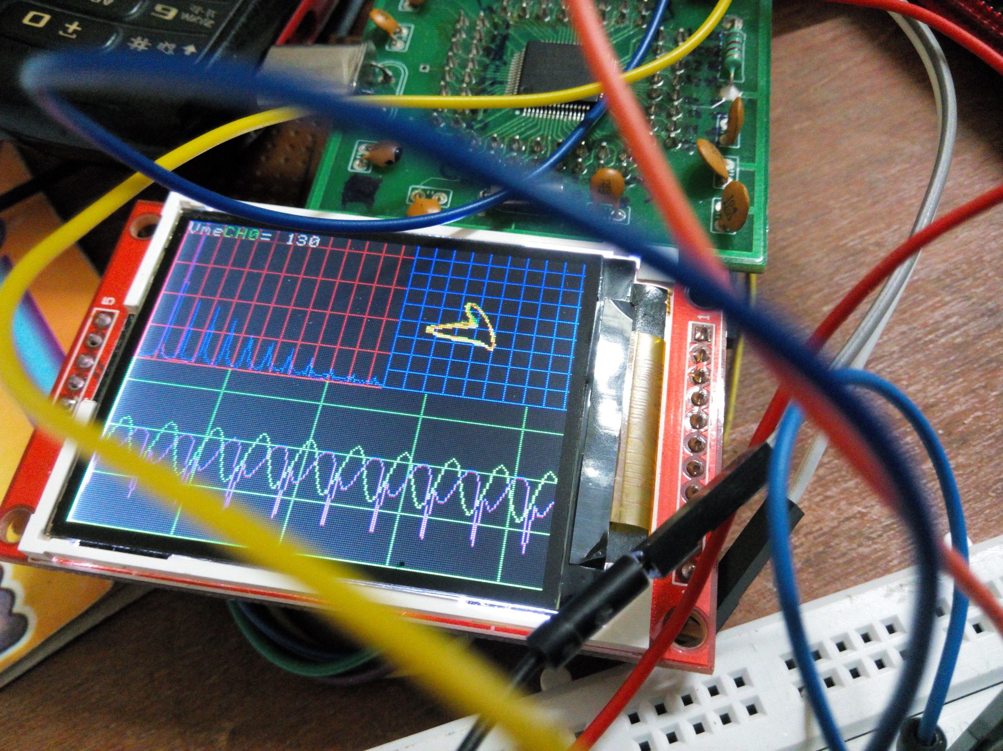
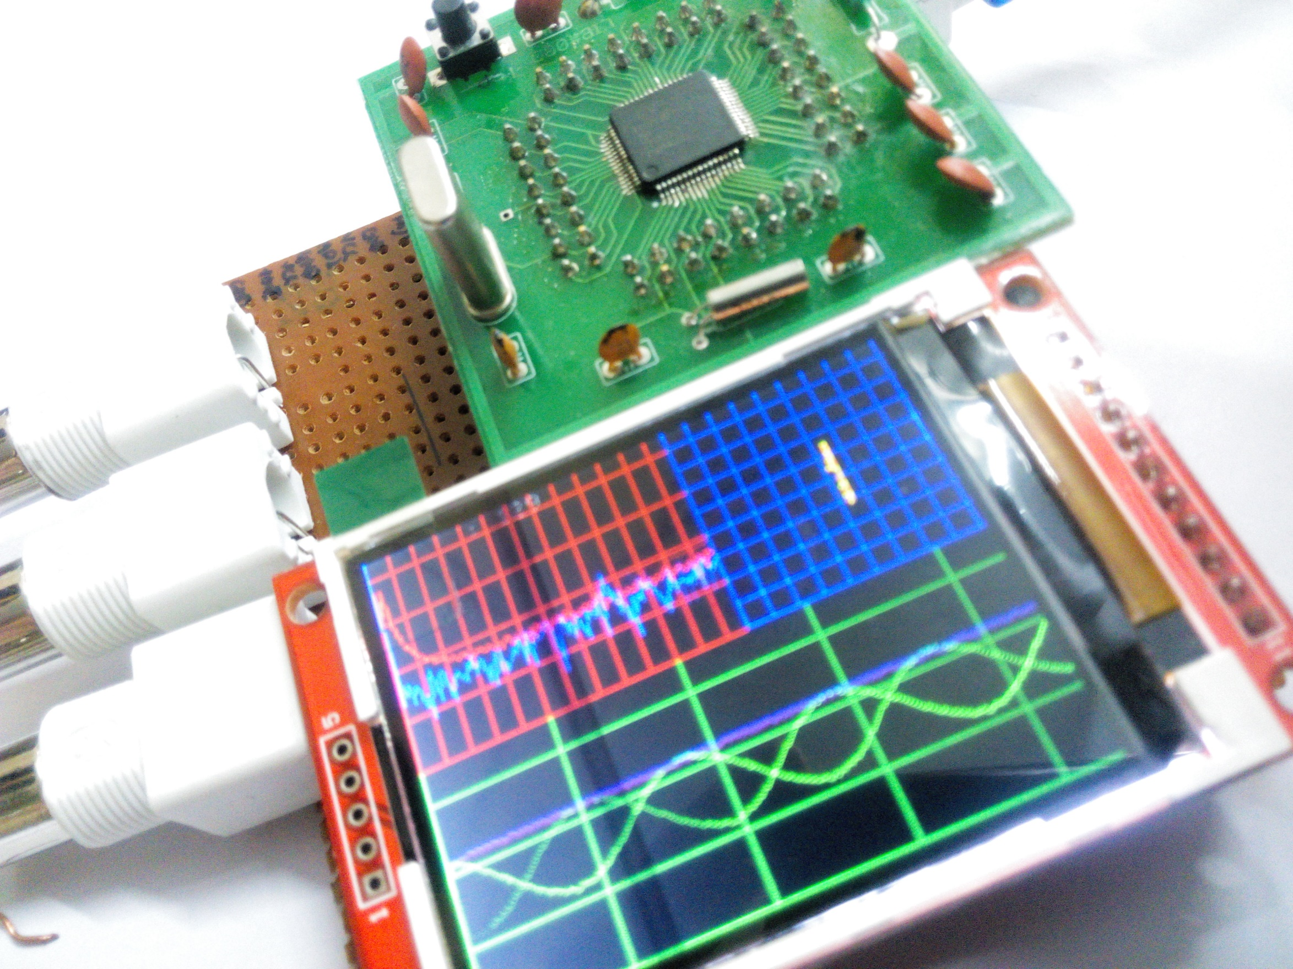
Digital Oscilloscope …Electrical Engineer’s Stethoscope
Ajinkya Gorad , 2nd year undergrad (Electrical Engineering) , IIT Bombay
Objective
Timelines
Results
Creating a cheap oscilloscope for student / hobby use.
Features of Dual Channel, Spectrum, X-Y Plot, Portability ( Battery Powered )
Prototype 0
Signal Acquisition & Display ( LCD display optimization)
Spectrum
Processing on Raw data (FFT) for Spectrum
Optimization
Making it pretty and optimizing for faster refresh rate
X-Y plot
Adding X-Y Plot without compromising much of performance
About
Project Overview
BLOCK DIAGRAM
Include results based on your experiments
Result 2
Result 3
Type a brief overview or summary of your project. (Click the Bullets button on the Home tab to remove the bullets.)
Materials (detailed list) | Quantity (be specific)
LPC2148 ARM Processor | 1
ILI9225 TFT Display (2.2”) | 1
Item | Amount
Item | Amount
Item | Amount
Item | Amount
Item | Amount
Future Ideas
Including on board storage and USB connection for data logging
Adding flexible input circuitry
Design on PCB to reduce further cost and size
Variables / Research
Data / Observations
Controlled variables
These are kept the same throughout your experiments
Independent variable
The one variable you purposely change and test
Dependent variable
The measure of change observed because of independent variable
Decide how you will measure the change
Observation 1
Observation 2
Observation 3
Resources
FFT algorithm http://staff.science.nus.edu.sg/~phywjs/CZ5101/fft.c written by Wang Jian-Sheng.
Project source at https://github.com/ajinkyagorad/LPC_2148_OSCLLOSCOPE
Contact Mail : ajinkyagorad@gmail.com

